Slide 1
Steam Game Analysis
CAPSTONE PROJECT
Presented By:
RANJITH M
9513-JAYARAJ ANNAPACKIAM CSI COLLEGE OF ENGINEERING
B.E MECHANICAL ENGINEERING

Slide 2
OUTLINE
Problem Statement
Proposed System/Solution
System Development Approach
Algorithm & Deployment
Result
Conclusion
Future Scope
References

Slide 3
Problem Statement
The problem statement for a Steam game analysis could involve various aspects, such as:
User Behavior Analysis: Understanding player interactions within the game, including playtime, in-game purchases, and social interactions.
Game Performance Evaluation: Assessing game stability, bugs, crashes, and performance on different hardware configurations.
Market Analysis: Examining the game's sales, revenue, and trends compared to similar titles on the platform.
Player Satisfaction: Gathering and analyzing player feedback, reviews, and ratings to gauge overall satisfaction and identify areas for improvement.
Competitive Landscape: Studying competitor games, their features, pricing, and player base to strategize marketing and development efforts.
Predictive Modeling: Using data to predict future trends, such as player retention, revenue growth, or potential expansions.
Each of these aspects could be further detailed based on the specific objectives and context of the analysis.

Slide 4
Proposed Solution
A proposed solution for Steam game analysis could involve:
Data Collection:Gather data from various sources such as Steam API, game telemetry, reviews, forums, and social media platforms.
Data Processing: Clean, preprocess, and aggregate the collected data to make it suitable for analysis. This may involve handling missing values, outliers, and merging datasets.
Exploratory Data Analysis (EDA):Conduct EDA to understand the characteristics of the data, identify patterns,
correlations, and anomalies. This step helps in formulating hypotheses and guiding further analysis.
Statistical Analysis: Use statistical methods to analyze player behavior, revenue trends, market dynamics, and player satisfaction metrics. This could include hypothesis testing, regression analysis, and time-series forecasting.
Machine Learning Models: Develop predictive models to forecast key metrics such as player churn, revenue projections, and game popularity. Techniques like classification, regression, and clustering can be applied depending on the specific analysis goals.

Slide 5
Visualization and Reporting: Present the findings through interactive visualizations, dashboards, and comprehensive reports. Communicate insights effectively to stakeholders and provide actionable recommendations for game developers and publishers
Iterative Improvement: Continuously refine the analysis based on feedback, new data, and changing market dynamics to ensure the relevance and accuracy of insights provided.

Slide 6
System Approach
A system approach to Steam game analysis involves:
Data Collection: Gather diverse data from Steam API, player statistics, in-game telemetry, reviews, and social media platforms.
Data Integration: Merge and preprocess data from various sources to create a unified dataset for analysis.
Feature Engineering: Extract meaningful features from the data, such as player demographics, gameplay metrics, and user-generated content.
Model Development: Utilize statistical analysis, machine learning, and data mining techniques to develop predictive models for player behavior, game performance, and market trends.
Visualization: Create interactive visualizations and dashboards to explore and communicate insights effectively to stakeholders.
Feedback Loop: Incorporate feedback from developers, players, and market trends to continuously improve the analysis system and adapt to changing circumstances.

Slide 7
Automation: Implement automation for data collection, preprocessing, model training, and reporting to streamline the analysis process and ensure scalability.
Security and Privacy: Ensure data security and privacy compliance throughout the analysis pipeline, especially when dealing with sensitive player information.
Collaboration: Foster collaboration between analysts, developers, and other stakeholders to leverage domain expertise and ensure the relevance of insights generated
Evaluation: Regularly evaluate the performance and accuracy of the analysis system against predefined metrics and benchmarks to maintain its effectiveness.

Slide 8
Algorithm & Deployment
Algorithm
Creating a Steam game analysis algorithm involves several steps:
Data Collection: Gather data from the Steam platform, including game titles, genres, user reviews, playtime, and other relevant metrics.
Feature Engineering: Extract meaningful features from the collected data, such as user ratings, playtime distribution, release date, developer reputation, and genre popularity.
Algorithm Selection: Choose appropriate machine learning algorithms for analysis, such as regression for predicting sales, clustering for grouping similar games, or sentiment analysis for assessing user reviews.
Training: Train the chosen algorithms using historical data to learn patterns and relationships between features and game success metrics.
Evaluation: Assess the performance of the trained models using metrics like accuracy, precision, recall, or Mean Squared Error (MSE) depending on the specific analysis goals.
Remember, the effectiveness of the algorithm depends on the quality of the data and the features selected, as well as the robustness of the chosen machine learning techniques.

Slide 9
Deployment
Deploying a Steam game analysis system involves integrating the developed algorithm into a usable platform. Here's how you can do it:
User Interface: Design an intuitive user interface where users can input game titles or browse through a list of games. This interface should display analysis results in a clear and understandable format
Backend Infrastructure: Set up a backend infrastructure to handle user requests, process data, and run the analysis algorithm. This may involve cloud services for scalability and reliability
Data Integration: Connect the system to the Steam API or other data sources to fetch real-time information about games, including metadata, user reviews, sales data, and player statistics
Algorithm Integration: Integrate the analysis algorithm into the backend system, ensuring it can handle large volumes of data efficiently and provide timely responses to user queries
Scalability and Performance: Optimize the system for scalability and performance to handle varying loads of user requests and ensure responsiveness during peak times
Security: Implement security measures to protect user data and prevent unauthorized access to the system, especially if it involves handling sensitive information.

Slide 10
Monitoring and Maintenance: Set up monitoring tools to track system performance and usage metrics. Regularly update the system to incorporate new features, fix bugs, and address emerging security threats
User Feedback and Improvement: Gather feedback from users to identify areas for improvement and enhance the system's functionality and usability over time
By following these steps, you can deploy a robust and effective Steam game analysis platform that provides valuable insights to developers, publishers, and gamers.

Slide 11
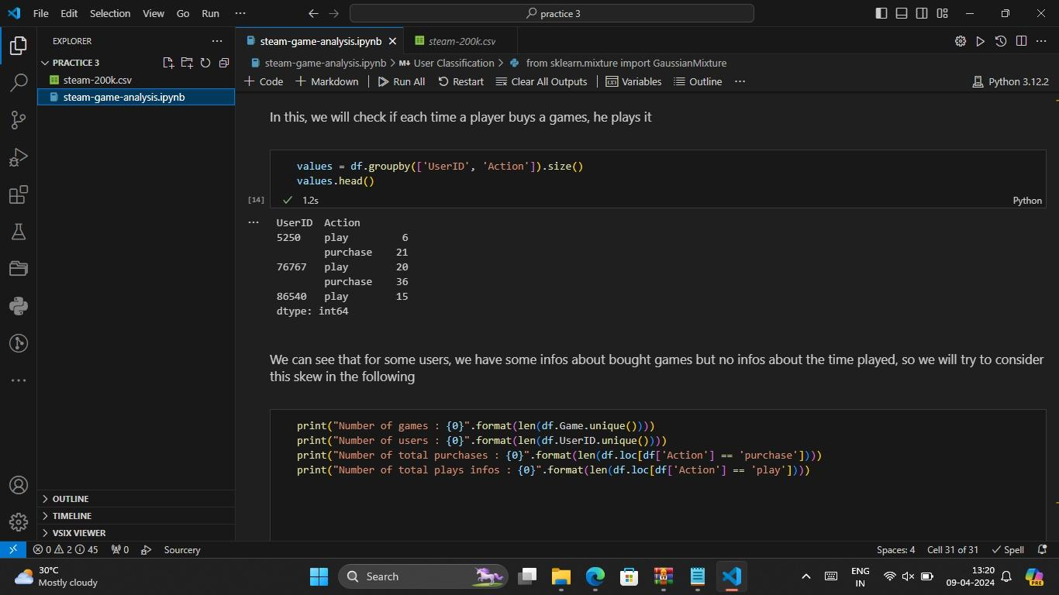
Result

Slide 12
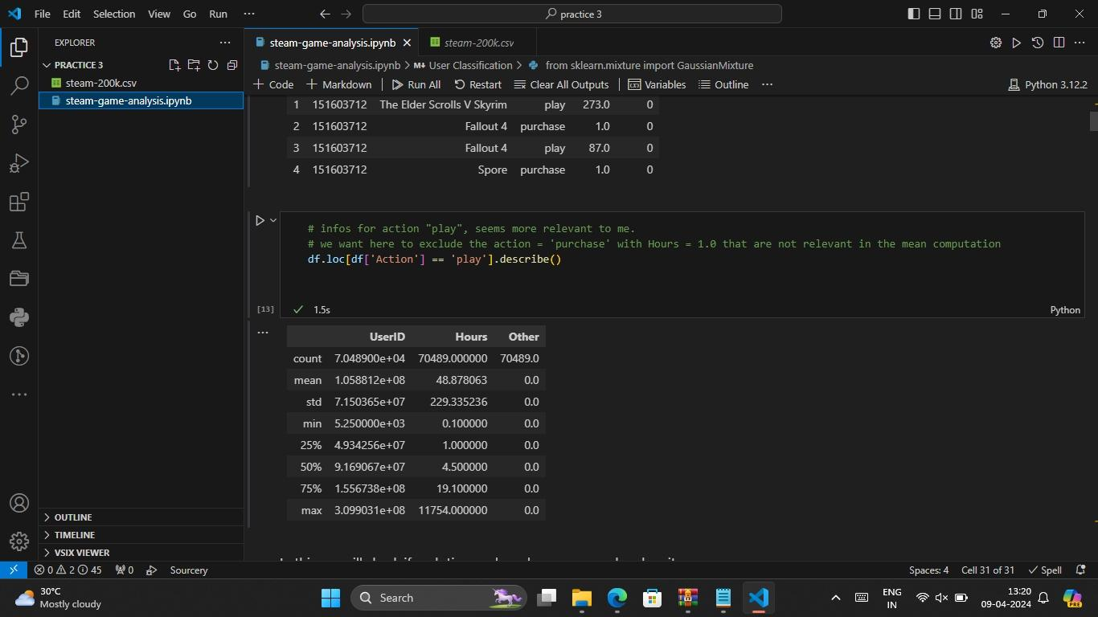

Slide 13
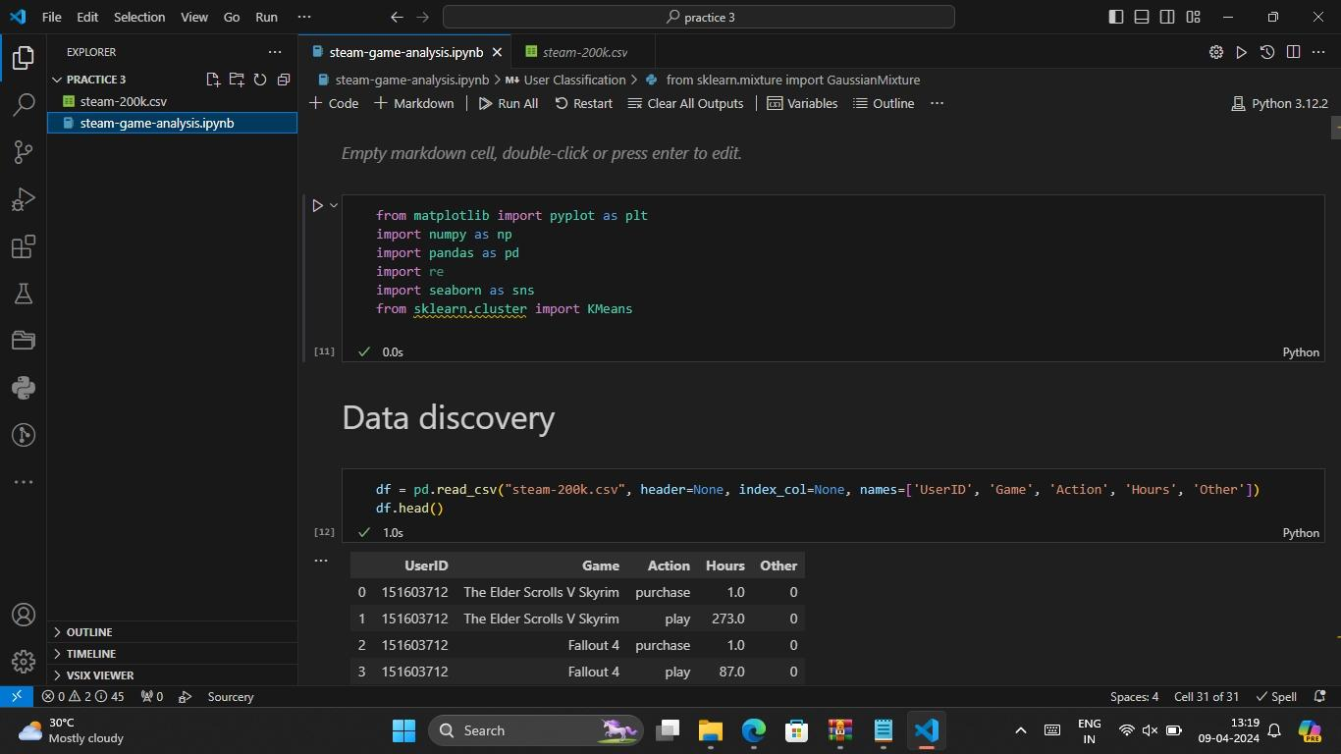

Slide 14
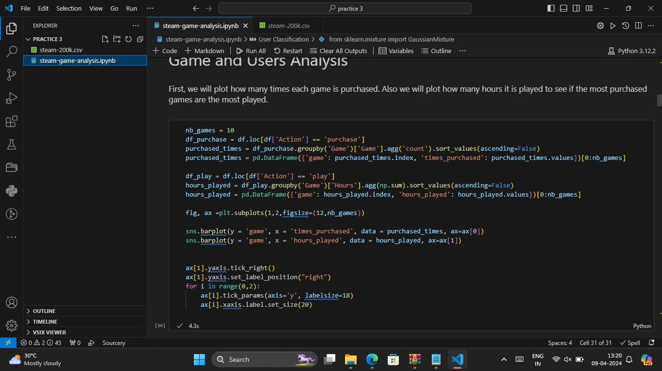

Slide 15
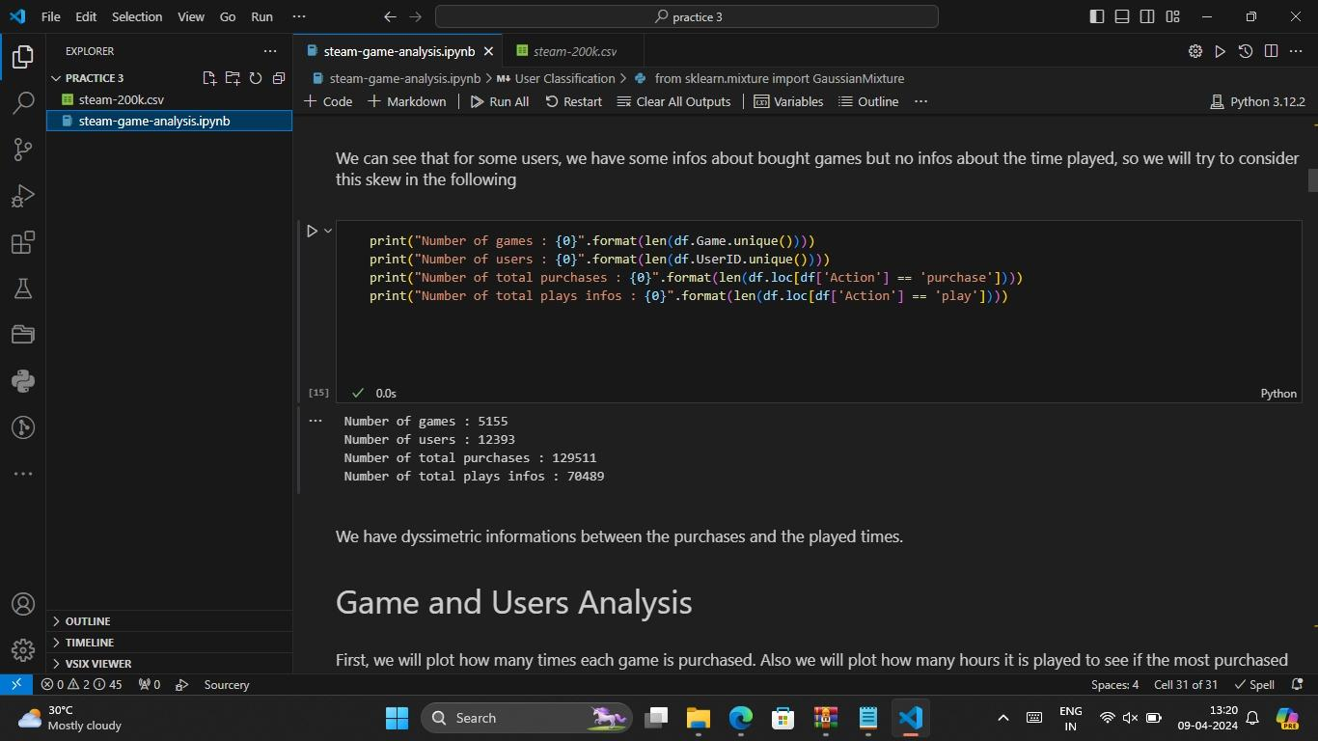

Slide 16
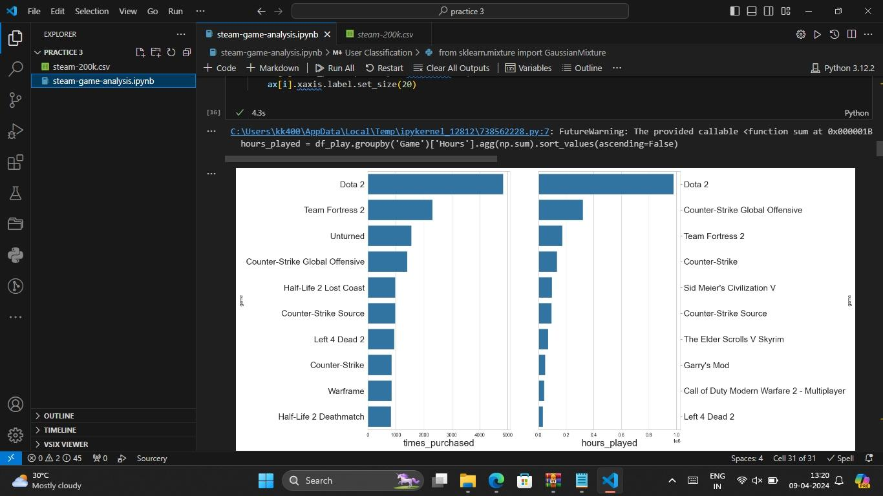

Slide 17
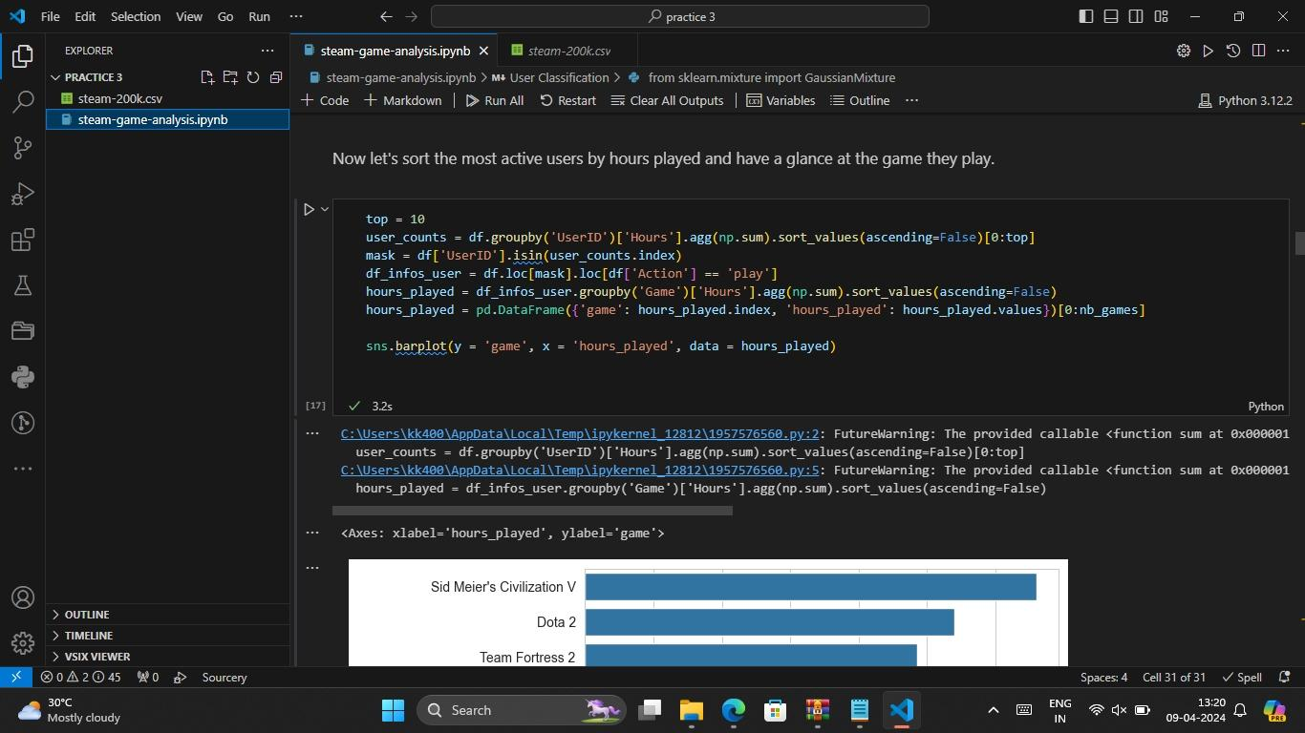

Slide 18
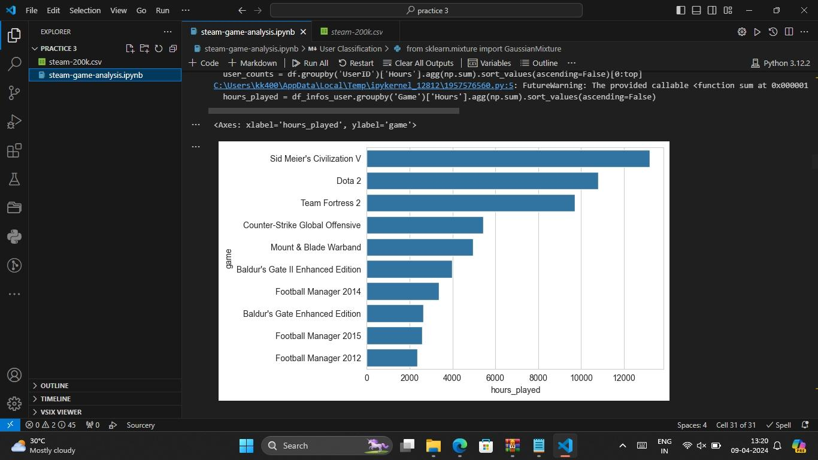

Slide 19
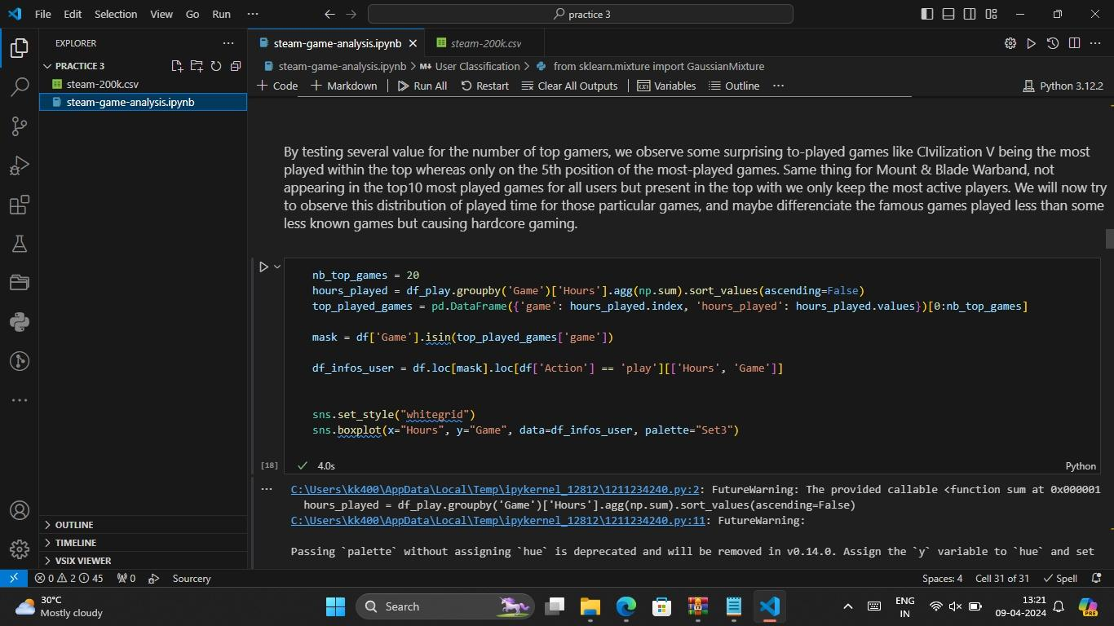

Slide 20
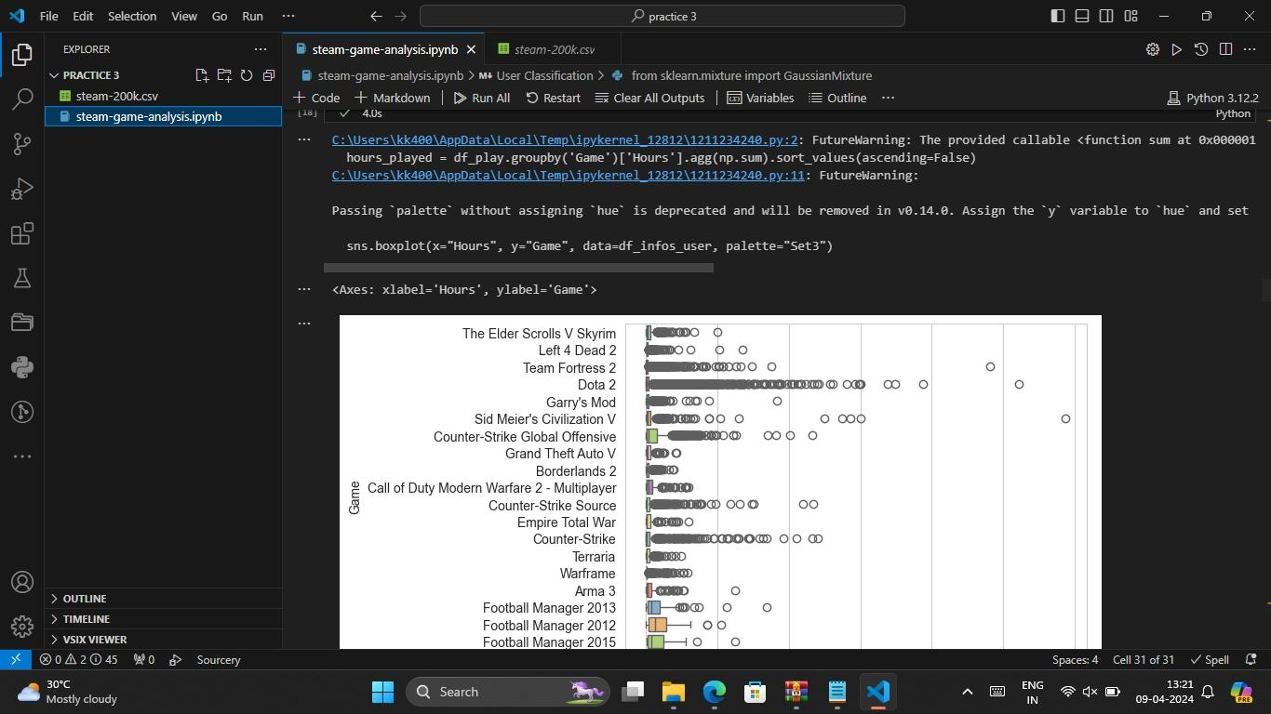

Slide 21
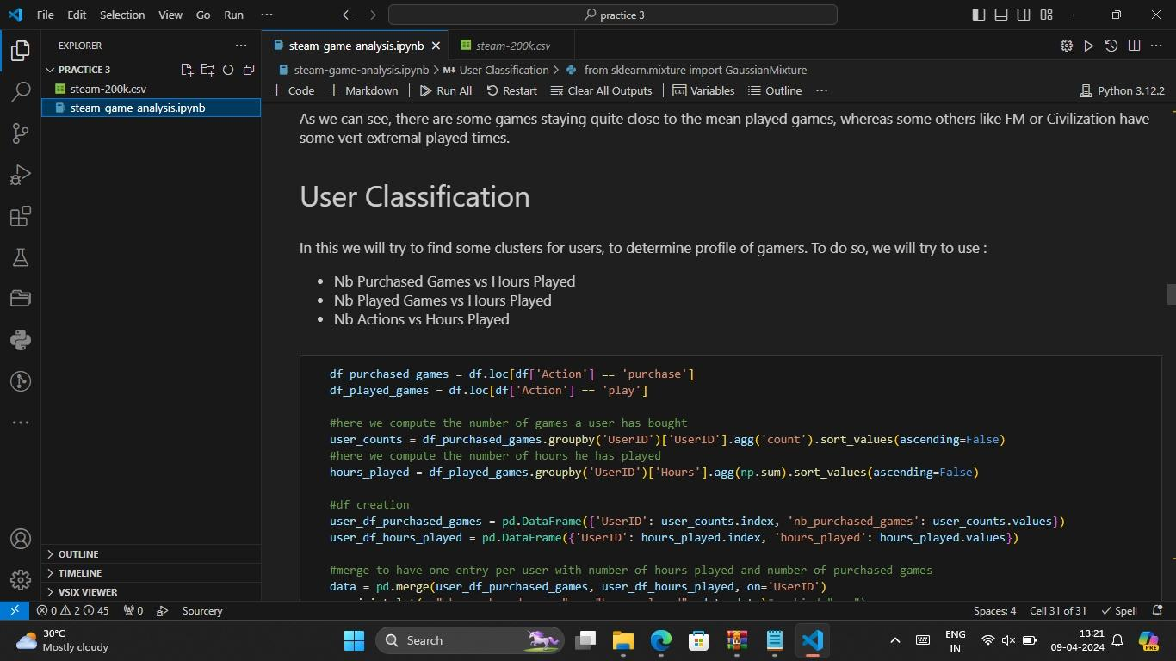

Slide 22
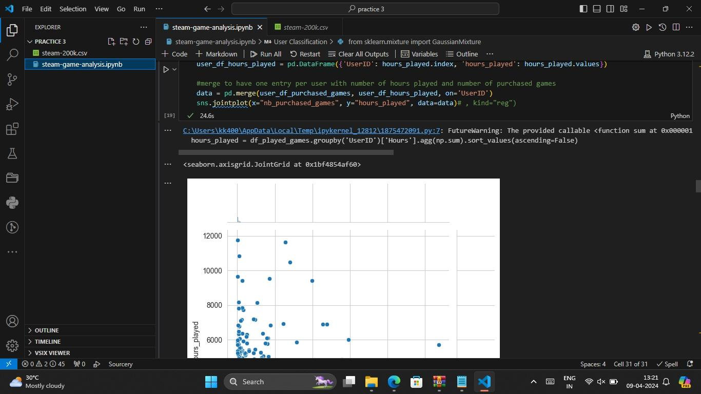

Slide 23
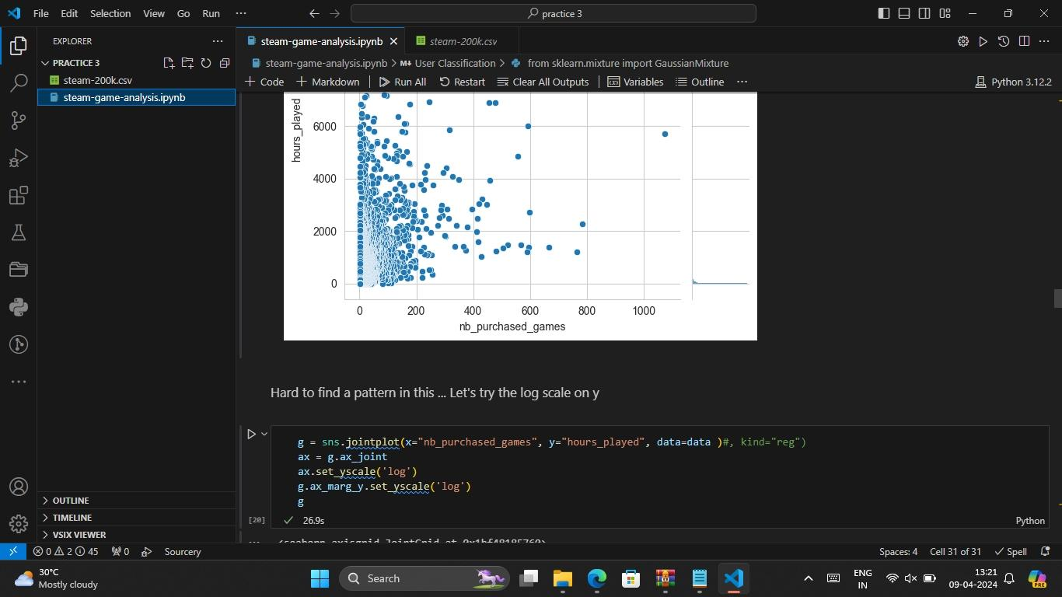

Slide 24
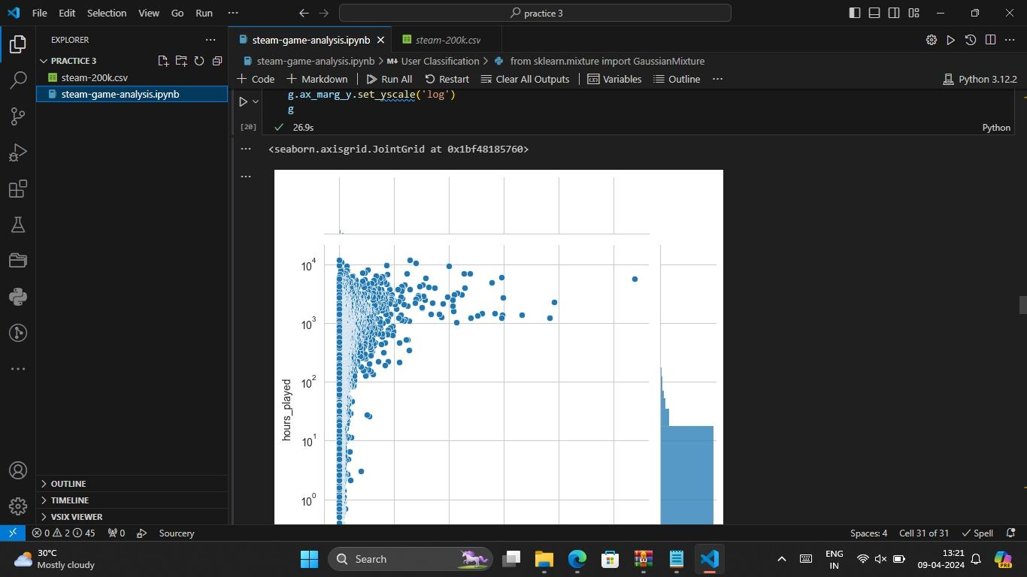

Slide 25
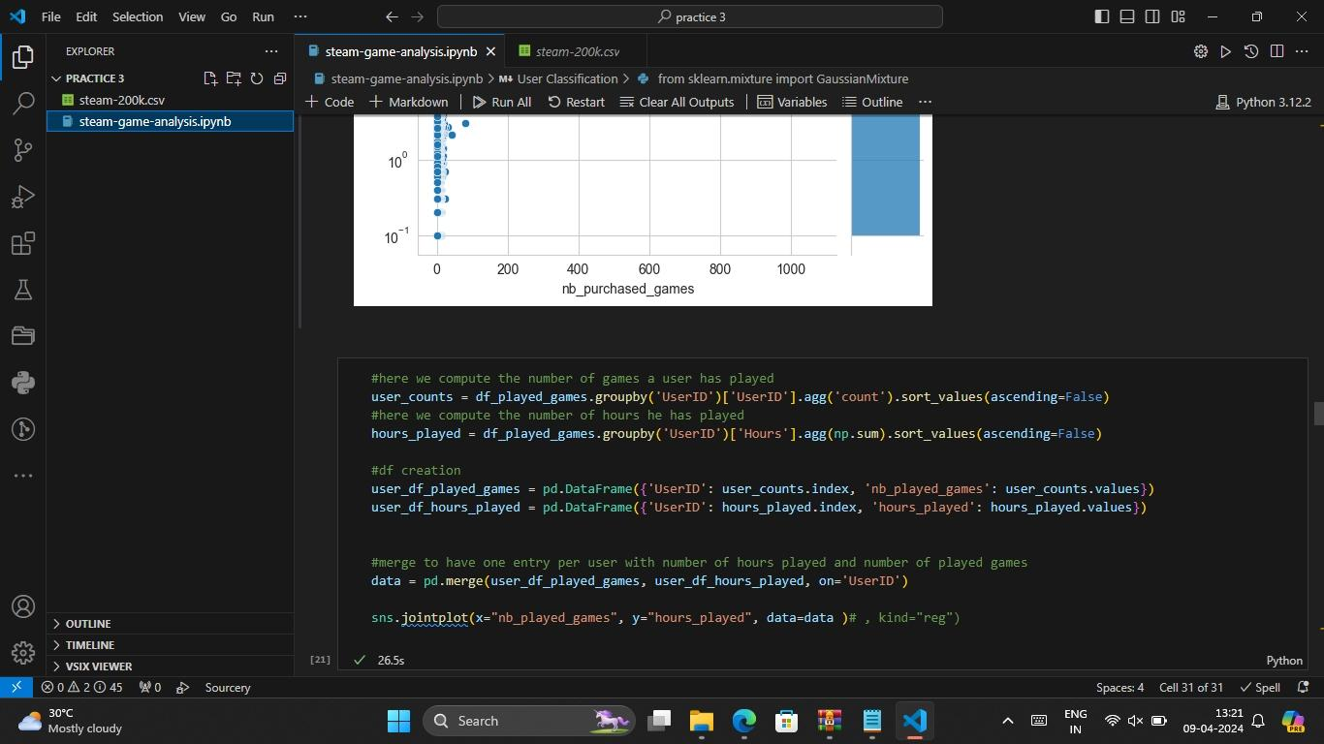

Slide 26
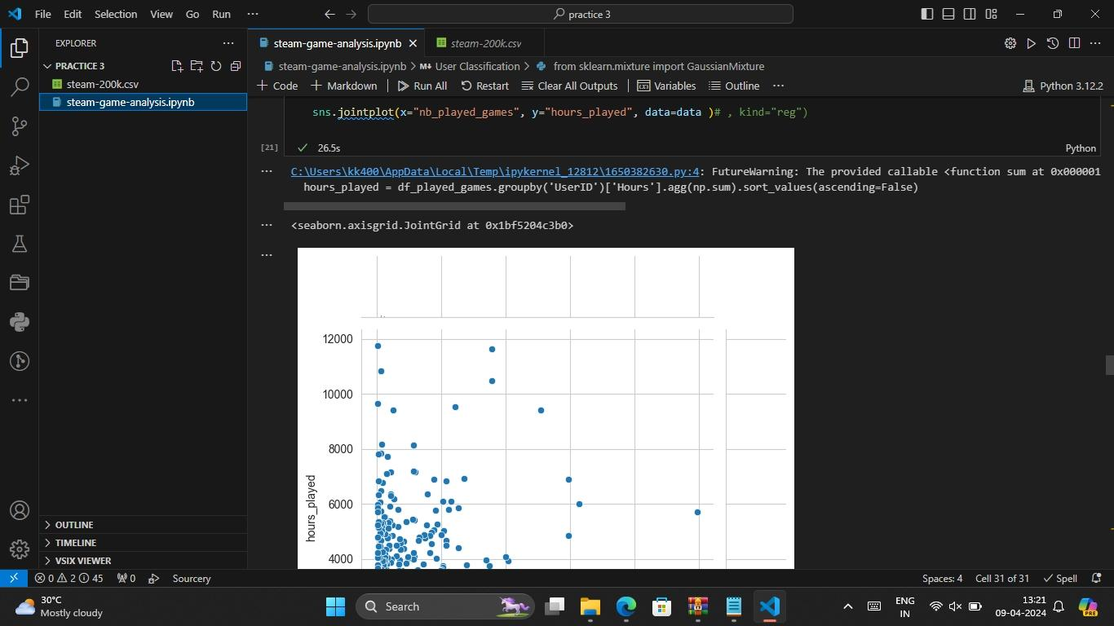

Slide 27


Slide 28
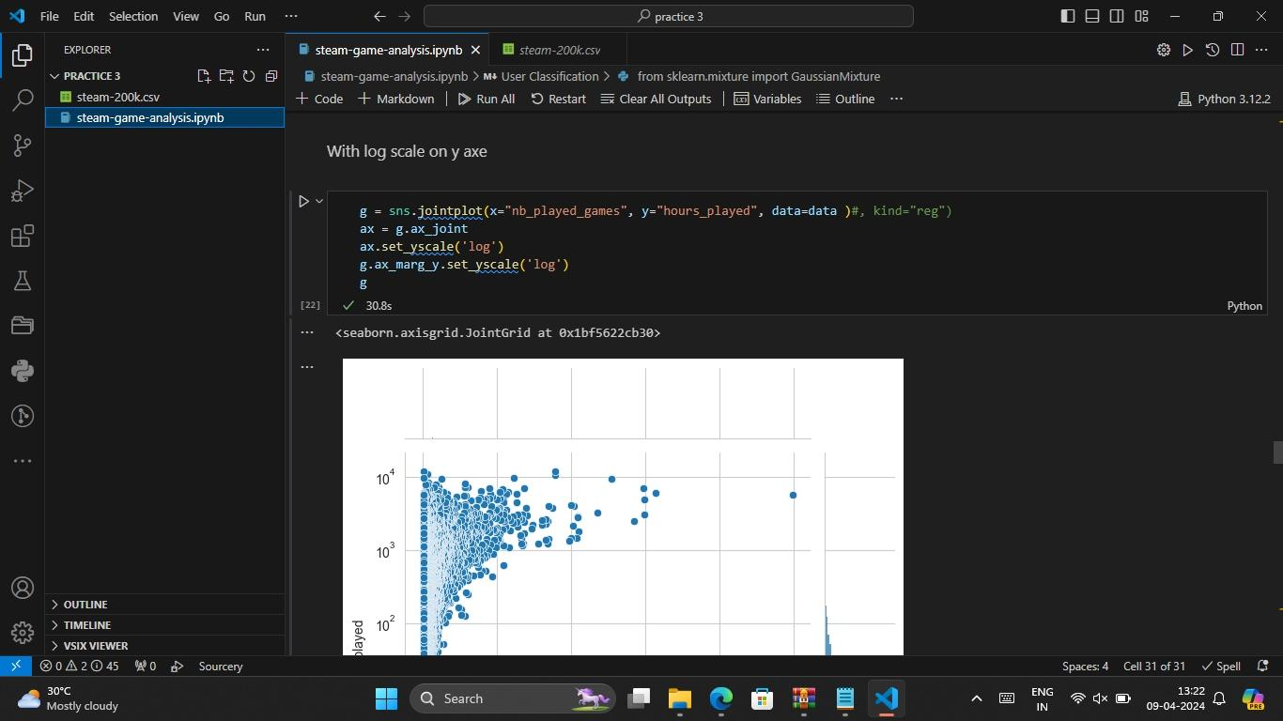

Slide 29
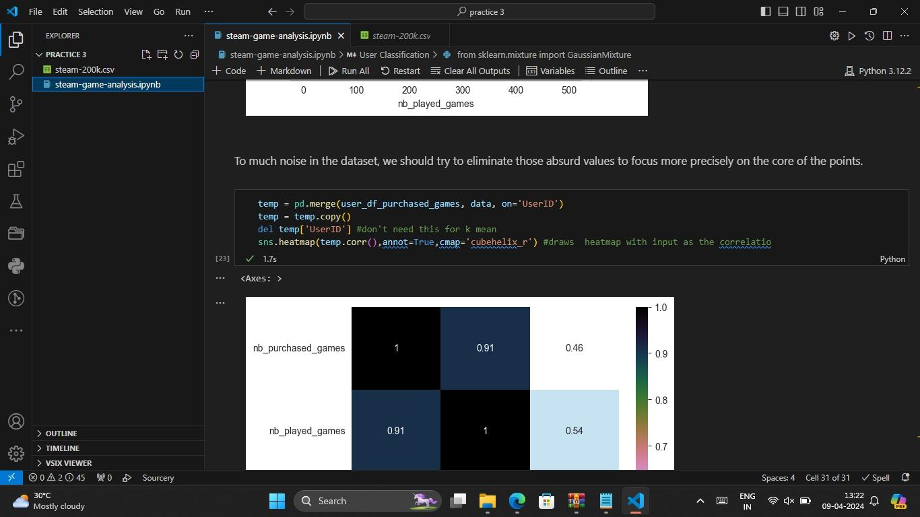

Slide 30
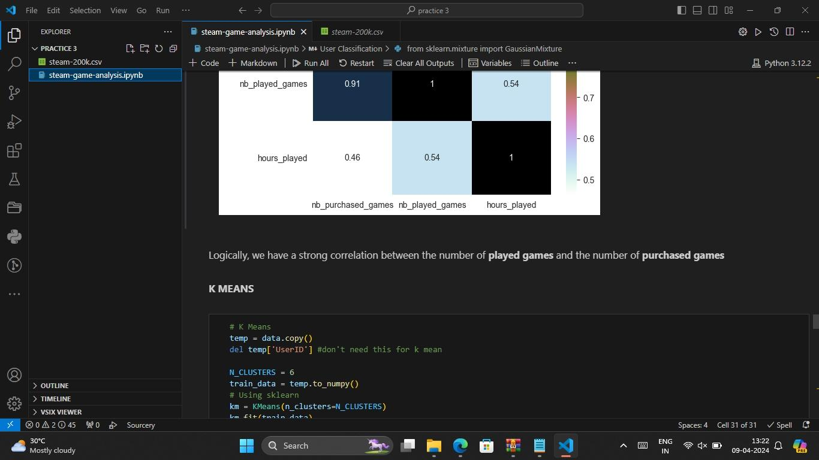

Slide 31
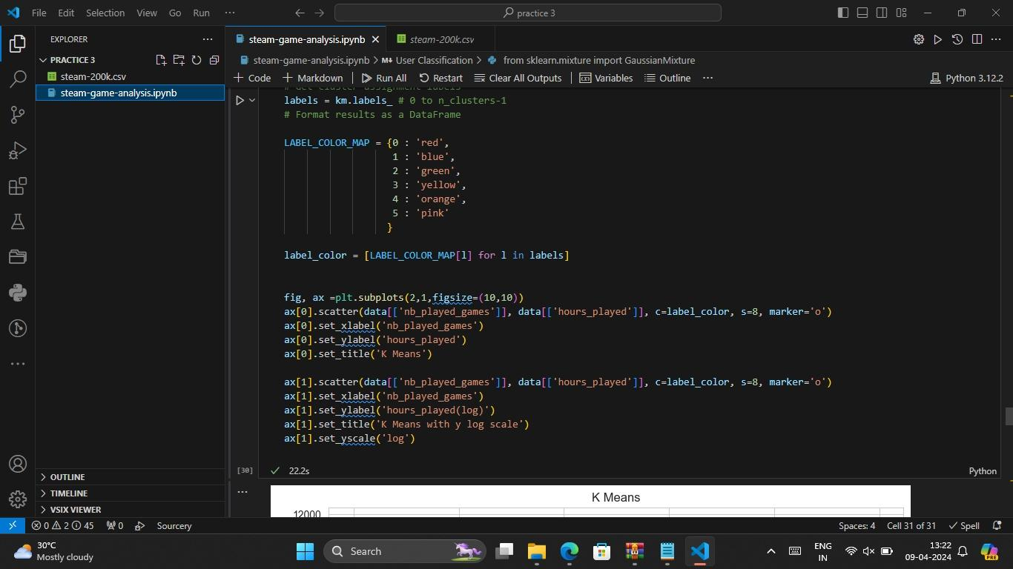

Slide 32
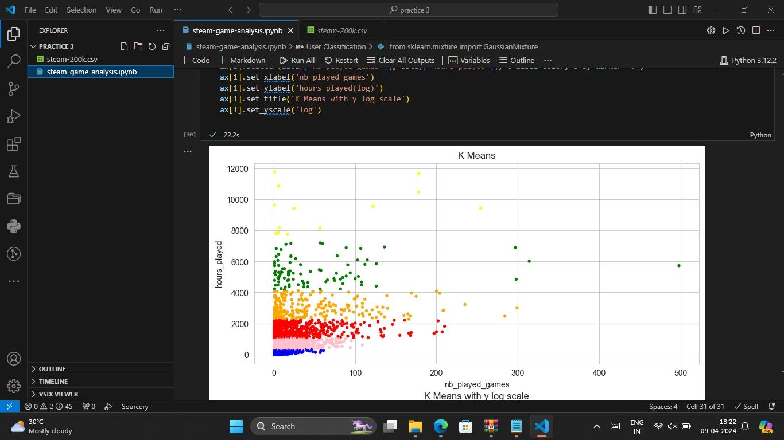

Slide 33
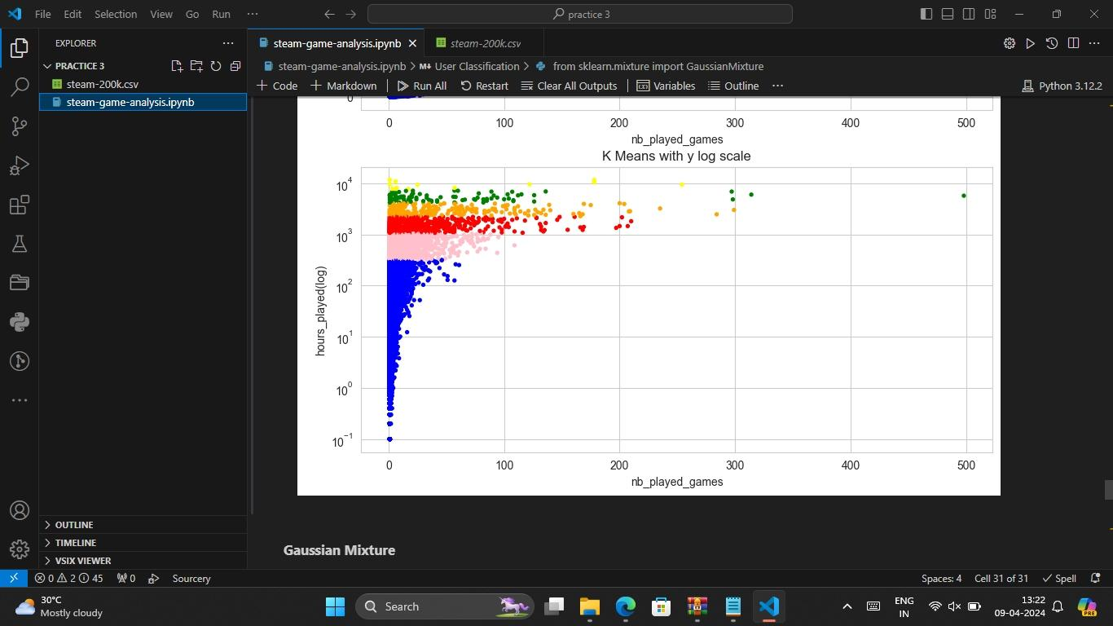

Slide 34
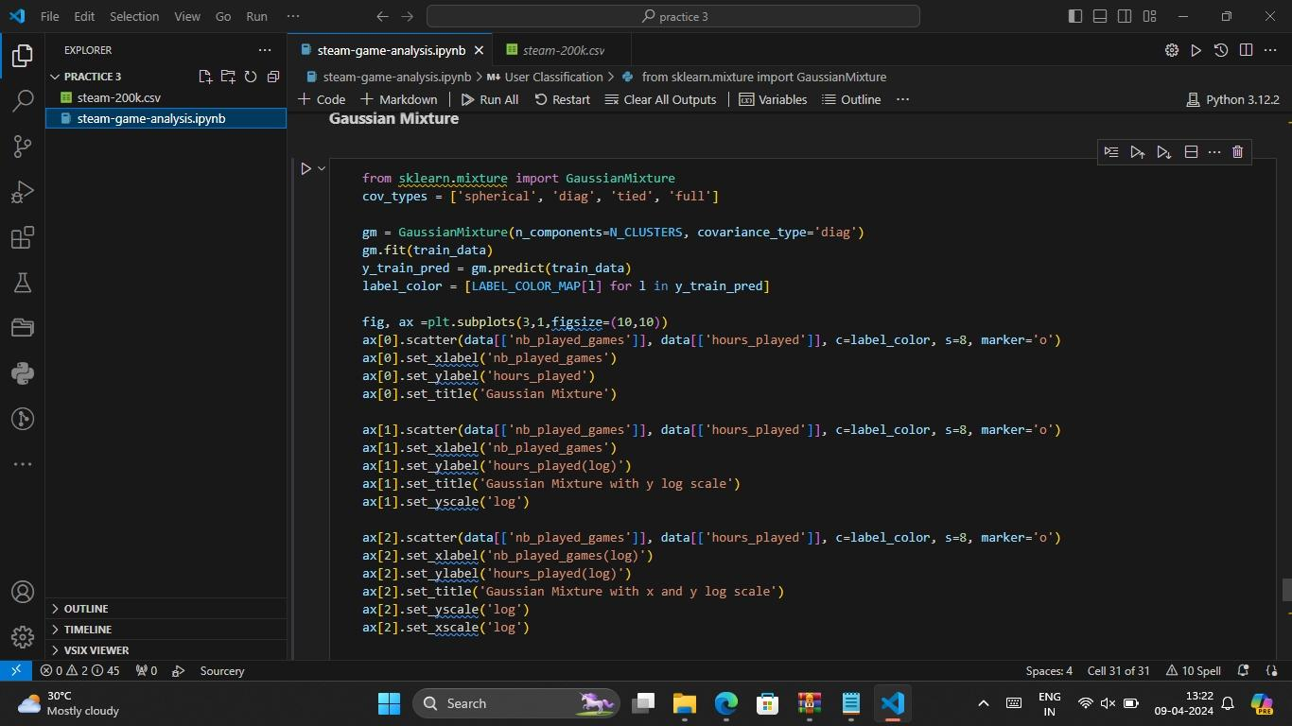

Slide 35
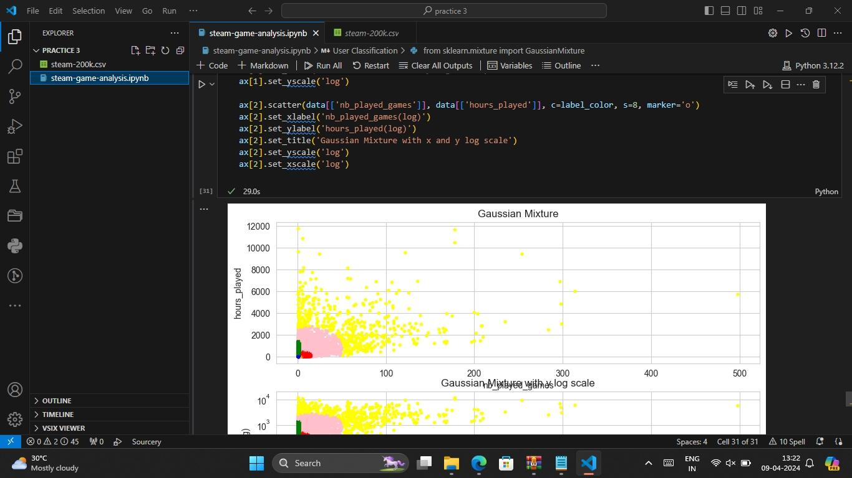

Slide 36
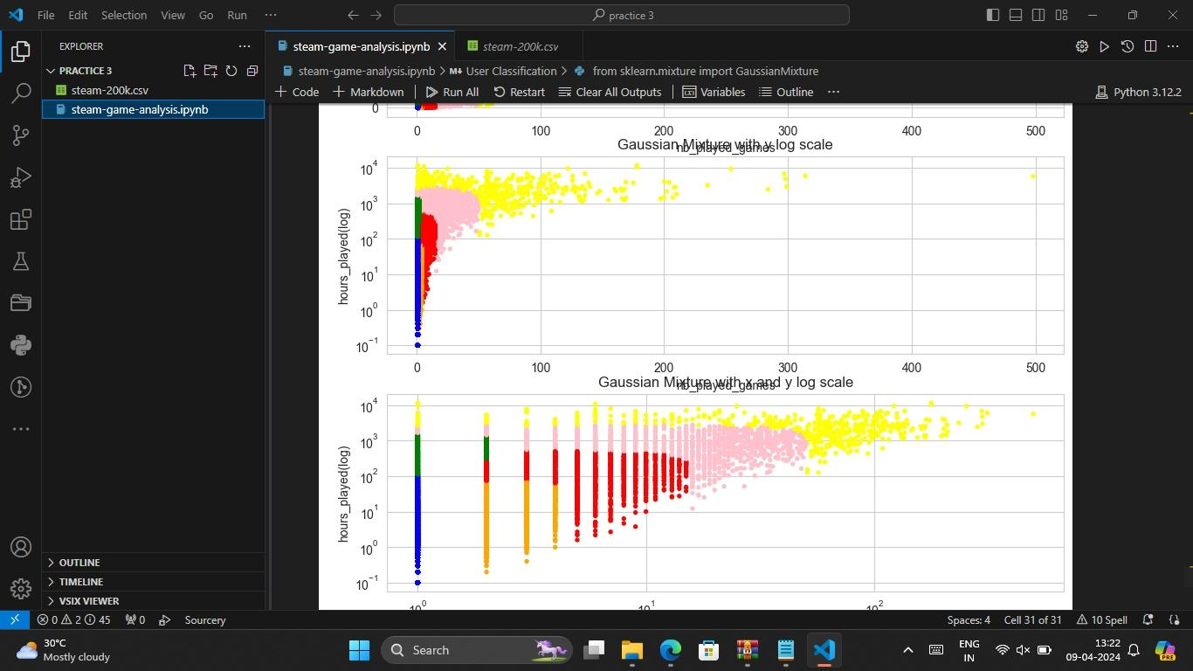

Slide 37
Conclusion
In conclusion, developing a Steam game analysis system involves collecting data, engineering features, selecting algorithms, training models, and deploying the system for practical use. By integrating user-friendly interfaces, robust backend infrastructure, real-time data integration, and security measures, developers can create a valuable tool for assessing game performance, predicting success metrics, and offering insights to stakeholders in the gaming industry. Continuous iteration, monitoring, and user feedback are essential for refining the system and ensuring its effectiveness over time. Overall, a well-designed and deployed Steam game analysis platform can provide valuable insights that benefit developers, publishers, and gamers alike.

Slide 38
Future scope
The future scope of Steam game analysis holds significant potential for further advancements and applications:
Advanced Machine Learning Techniques: Incorporating cutting-edge machine learning techniques such as deep learning and reinforcement learning can enhance the accuracy and predictive power of analysis models.
Personalized Recommendations: Utilizing user behavior data and advanced recommendation algorithms can offer personalized game recommendations tailored to individual preferences and gaming habits.
Predictive Analytics: Enhancing predictive analytics capabilities to forecast future trends in the gaming industry, such as identifying emerging genres or predicting player retention rates.
Incorporating External Data Sources: Integrating data from social media, streaming platforms, and other external sources can provide a more comprehensive understanding of player preferences and market dynamics.

Slide 39
Real-time Analysis: Developing real-time analysis capabilities to provide instant insights into game performance, user sentiment, and market trends, enabling timely decision-making for developers and publishers.
Cross-platform Integration: Expanding analysis capabilities to include games across multiple platforms, such as consoles, mobile devices, and cloud gaming services, to offer a holistic view of the gaming ecosystem.
Ethical Considerations: Addressing ethical concerns related to data privacy, bias in algorithms, and responsible use of analysis results to ensure transparency and fairness in decision-making processes.
AI-driven Game Development: Leveraging game analysis insights to inform AI-driven game development processes, including procedural content generation, dynamic difficulty adjustment, and personalized gaming experiences.
By exploring these avenues, the future of Steam game analysis holds promise for advancing the gaming industry, empowering developers with actionable insights, and enhancing the gaming experience for players worldwide.

Slide 40
References
There aren't specific books dedicated solely to Steam game analysis, but you can find valuable insights in general game analysis and game design books. Some recommendations include
"Rules of Play: Game Design Fundamentals" by Katie Salen and Eric Zimmerman
Game Design Workshop: A Playcentric Approach to Creating Innovative Games" by Tracy Fullerton
"The Art of Game Design: A Book of Lenses" by Jesse Schell
"Game Analytics: Maximizing the Value of Player Data" by Magy Seif El-Nasr, Anders Drachen, and Alessandro Canossa
"Game Programming Patterns" by Robert Nystrom (useful for understanding common patterns and structures in game development, which can inform analysis).
For a more specific focus on analyzing digital games and their ecosystems, academic journals, articles, and online resources might be more up-to-date and relevant than traditional books.

Slide 41
THANK YOU

